Slide 1

Pitch Perfect: Mastering Visuals, Delivery, and Storytelling
LORATO KGOSIDIILE

Slide 2
“The most powerful person in the world is the story teller. The storyteller sets the vision, values and agenda ……..”
- STEVE JOBS

Slide 3
Session Objectives
Understand the essential components of an effective pitch, including structure, clarity, and audience engagement.
Learn how to apply visual storytelling techniques to create compelling and professional presentations.
Improve delivery through tone, body language, timing, and confidence-building tips.
Prepare for the final pitch with practical tools and real-time advice.

Slide 4
Why it matters
Understanding Pitch Structure
Confident Delivery
Visual Storytelling
Powerful Pitch

Slide 5

The 6-Part Pitch Framework
🎯 The Hook
Grab attention with a powerful fact, question, or story.
🔍 The Problem
Define the real-world challenge you're addressing.
💡 The Solution
Explain what you built and why it matters.
🚀 The Wow Factor
End strong with a demo, bold vision, or quote.
🤝 The Ask
Mention what you need (support, collaboration, etc.).
🌍 The Impact
Show the benefit or scalability of your solution.

Slide 6
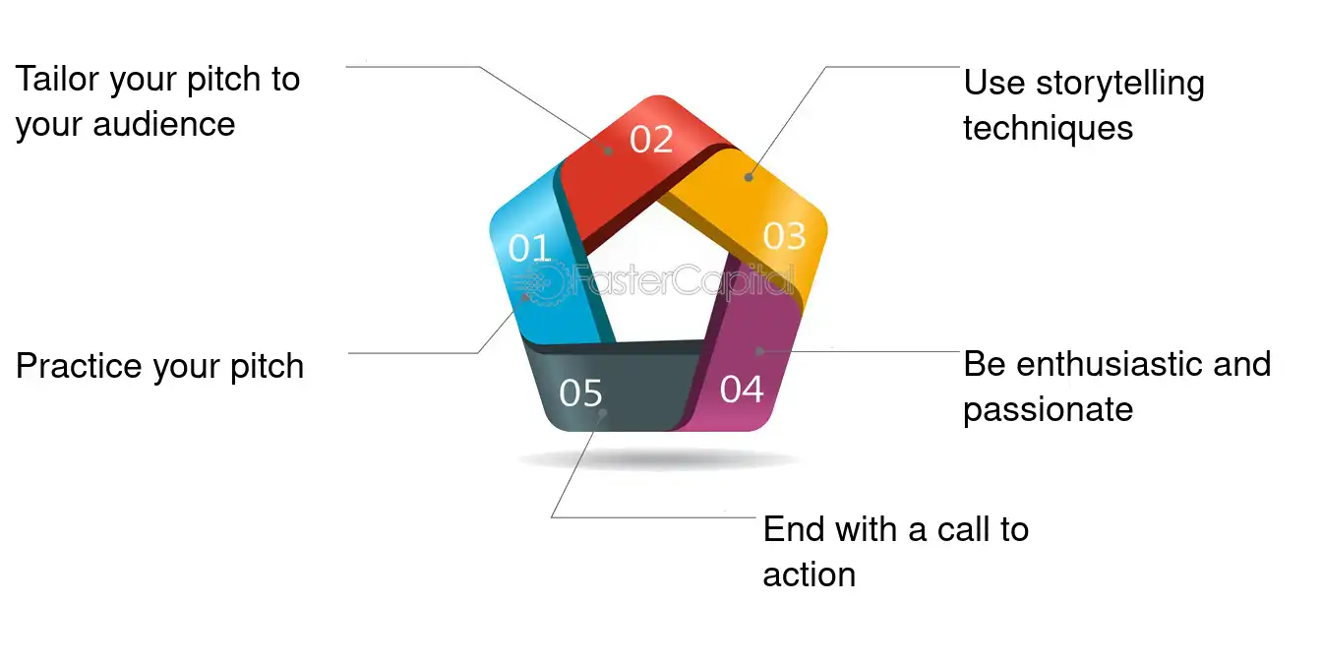

Delivery techniques

Slide 7



From Data to Impact
Speak Clearly. Think Deeply.
Content Highlights:
Know your Core Problem: Don’t pitch symptoms-solve the root.
Use Plain Language: Cut the jargon. “Tax breaks” beats “fiscal incentivisation.”
Make Slides Shine: One idea. One visual. No paragraph dumping.
Value Proposition Formula: “If X continues, Y loses Z; our product flips loss into A.”

Slide 8
Visual Design Tips
Design Like It Matters — Because It Does
Keep it Simple
Be Consistent
Use Visuals Over Text
Make Text Readable
Design for Storytelling

Slide 9
The Art of Story telling
Start with a clear, compelling problem that demands action.
Use relatable language and human stories to bring data to life.
Introduce a Character; Present the Conflict; Reveal the Solution; Position your product as the hero; Show the Impact End with Vision
Frame the issue with urgency and relevance.

Slide 10



Tools and Techniques for Impactful Communication
Tools: One-pagers, executive summaries, infographics Techniques: SCQA (Situation, Complication, Question, Answer), elevator pitch model
Digital tools for visual storytelling

Slide 11
Common Mistakes to Avoid
📖 Reading From Slides
Kills connection — know your story, speak it
📉 Too Much Text or Data
Simplify! One idea per slide
🎭 Overusing Jargon
Speak human. Avoid tech-overload
😰 Rushing or Dragging
Time yourself. Finish strong
🙈 Ignoring the Audience
Look up. Make eye contact
🌀 Lack of Structure
Follow a clear pitch flow

Slide 12



